Slide 1
Round-Robin Scheduling
• The round-robin (RR) scheduling algorithm is designed especially for timesharing systems.
• It is similar to FCFS scheduling, but preemption is added to enable the system to switch between processes.
• A small unit of time, called a time quantum or time slice, is defined, and is generally from 10 to 100 milliseconds in length.
• The ready queue is treated as a circular queue.
• The CPU scheduler goes around the ready queue, allocating the CPU to each process for a time interval of up to 1 time quantum.
• The CPU scheduler picks the first process from the ready queue, sets a timer to interrupt after 1 time quantum and dispatches the process.

Slide 2
Round-Robin Scheduling
• One of two things will then happen.
• The process's CPU burst.< 1 time quantum.
• The process itself will release the CPU voluntarily.
• The scheduler will then proceed to the next process in the ready queue.
• If the CPU burst > 1 time quantum,
• The timer will go off and will cause an interrupt to the operating system.
• A context switch will be executed, and the process will be put at the tail of the ready queue.
• The CPU scheduler will then select the next process in the ready queue.

Slide 3
Round-Robin Scheduling
• Advantages
• Round-robin is effective in a general-purpose, times-sharing system or transaction- processing system.
• Fair treatment for all the processes.
• Overhead on processor is low.
• Good response time for short processes.
• Disadvantages
• Care must be taken in choosing quantum value.
• Processing overhead is there in handling clock interrupt.
• Throughput is low if time quantum is too small

Slide 4
Example-1
• Consider the following set of processes that arrive at time 0, time quantum of 4 milliseconds, with the length of the CPU burst given in milliseconds:
• Process Burst Time
• P1 24
• P2 3
• P3 3

Slide 5
• wait = start-arrival
• finish = start+burst
• Turn Around (TA) = finish-arrival
• Process Burst Time
• P1 24
• P2 3
• P3 3
Example-1 - Solution
P1 | P2 | P3 | P1 | P1 | P1 | P1 | P1
0 4 7 10 14 18 22 26 30
Process | Burst Time | Arrival | Start | Wait | Finish | TA
1 | 24 | 0 | 0 | 6 | 30 | 30
2 | 3 | 0 | 4 | 4 | 7 | 7
3 | 3 | 0 | 7 | 7 | 10 | 10
• average waiting time: 5.67
• average turn around time: 15.67

Slide 6
Example-2 with time quantum 20
Process | Burst Time | Arrival | Start | Wait | Finish | TA
1 | 53 | 0 | 0 | ? | 134 | 134
2 | 17 | 0 | 20 | ? | 37 | 37
3 | 68 | 0 | 37 | ? | 162 | 162
4 | 24 | 0 | 57 | ? | 121 | 121
P1 | P2 | P3 | P4 | P1 | P3 | P4 | P1 | P3 | P3
0 20 37 57 77 97 117 121 134 154 162
Waiting times:
P1: (77-20)+(121-97)=81 average waiting time:
P2: (20-0) = 20 (81+20+94+97)/4 = 73
P3: (37-0)+(97-57)+(134-117)=94
P4: (57-0)+(117-77)=97

Slide 8
Priority Scheduling with First Come First Serve
• Run the process with the highest priority first.
• If two or more Processes with the same priority, use FFS
Example
Process Burst Time Priority
• P1 4 3
• P2 5 2
• P3 8 2
• P4 7 1
• P5 3 3

Slide 9
Exaple-1
Process Burst Time Priority
• P1 4 3
• P2 5 2
• P3 8 2
• P4 7 1
• P5 3 3
P4 | P2 | P3 | P1 | P5
0 7 12 20 24 27
Process | Burst Time | Priority | Arrival | Start | Wait | Finish | TA
1 | 4 | 3 | 0 | 20 | 20 | 24 | 24
2 | 5 | 2 | 0 | 7 | 7 | 12 | 12
3 | 8 | 2 | 0 | 12 | 12 | 20 | 20
4 | 7 | 1 | 0 | 0 | 0 | 7 | 7
5 | 3 | 3 | 0 | 24 | 24 | 27 | 27
Average |  |  |  |  | 12.6 |  | 18

Slide 10
Priority Scheduling with Round Robin
• Run the process with the highest priority.
• Processes with the same priority run round-robin with time quantum = 2
Example
Process Burst Time Priority
• P1 4 3
• P2 5 2
• P3 8 2
• P4 7 1
• P5 3 3

Slide 11
Process Burst Time Priority
• P1 4 3
• P2 5 2
• P3 8 2
• P4 7 1
• P5 3 3
Example-2
Time Quantum - 2
? | ? | ? | ? | ? | ? | ? | ? | ? | ?
?
Process | Burst Time | Priority | Arrival | Start | Wait | Finish | TA
1 | 4 | 3 | 0
2 | 5 | 2 | 0
3 | 8 | 2 | 0
4 | 7 | 1 | 0
5 | 3 | 3 | 0
Average |  |  |  |  | ? |  | ?

Slide 12
Process Burst Time Priority
• P1 4 3
• P2 5 2
• P3 8 2
• P4 7 1
• P5 3 3
Example-2
Time Quantum - 2
P4 | P2 | P3 | P2 | P3 | P2 | P3 | P1 | P5 | P1 | P5
0 7 9 11 13 15 16 20 22 24 26 27
Process | Burst Time | Priority | Arrival | Start | Wait | Finish | TA
1 | 4 | 3 | 0 | 20 | 22 | 26 | 26
2 | 5 | 2 | 0 | 7 | 11 | 16 | 16
3 | 8 | 2 | 0 | 9 | 12 | 20 | 20
4 | 7 | 1 | 0 | 0 | 0 | 7 | 7
5 | 3 | 3 | 0 | 22 | 24 | 27 | 27
Average |  |  |  |  | 13.8 |  | 19.2

Slide 14
Multilevel Queue Scheduling
• MQS scheduling algorithms has been created for situations in which processes are easily classified into different groups.
• foreground (interactive) processes and
• background (batch) processes.
• These two types of processes have different response-time requirements and so may have different scheduling needs.

Slide 15
Multilevel Queue Scheduling...
• Foreground processes may have priority (externally defined) over background processes.
• Separate queues might be used for foreground and background processes.
• The foreground queue might be scheduled by an RR algorithm, while the background queue is scheduled by an FCFS algorithm.

Slide 16
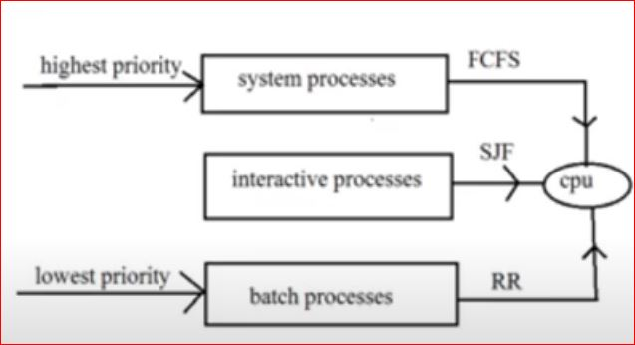
Multilevel Queue Scheduling...
• A multilevel queue scheduling algorithm divides the ready queue into several separate queues based on some property of the process,
• such as memory size, process priority, or
process type.
• Multilevel queue scheduler defined by the:
• Number of queues
• Scheduling algorithms for each queue
• Method used to determine which queue a
process will enter, when that process
needs service
• Scheduling among the queues

Slide 17
Multilevel Queue Scheduling...
• scheduling among the queues,
• which is commonly implemented as fixed-priority preemptive scheduling.
• For example, the foreground queue may have absolute priority over the background queue.
• Let's look at an example of a multilevel queue scheduling algorithm with five queues, listed below in order of priority:
• 1. System processes
• 2. Interactive processes
• 3. Interactive editing processes
• 4. Batch processes
• 5. Student processes

Slide 18
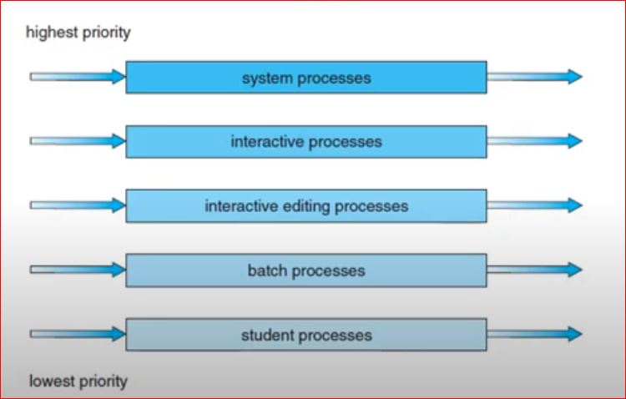
Multilevel Queue Scheduling...
Prioritization based upon process type

Slide 19
Multilevel Queue Scheduling
• Each queue has its own scheduling algorithm.
• The foreground queue might be scheduled by an RR algorithm,
• while the background queue is scheduled by an FCFS algorithm.
• there must be scheduling among the queue and is generally implemented as fixed priority preemptive scheduling.

Slide 20
Multilevel Queue Scheduling
• The batch process will execute, only if the queues for system processes, interactive processes, and interactive editing processes were all empty.
• If an interactive editing process entered the ready queue while a batch process was running, the batch process would be preempted.

Slide 21
Multilevel Queue Scheduling...
• The time-slice among the queues.
• Each queue gets a certain portion of the CPU time,
• The foreground queue can be given 80 percent of the CPU time for RR scheduling among its processes,
• The background queue receives 20 percent of the CPU to give to its processes on an FCFS basis.

Slide 22
Drawbacks of Multilevel Queue Scheduling
•In multilevel queue scheduling we assign a process to a queue, and it remains in that queue until the process is allowed access to the CPU.
• That is, processes do not move between queues.
• The batch processes do not suddenly change to an interactive process and vice versa.
• Multilevel feedback queue scheduling allows us to do this.

Slide 24
Multilevel Queue Scheduling Vs Multilevel Feedback Queue Scheduling
• That is, processes do not move between queues.
• Multilevel feedback queue scheduling allows us to do this.
• There is no fixed queue for the processes.
• A process can move between the various queues.

Slide 25
Multilevel Feedback Queue Scheduling...
• Aging of Processes
• If a process uses too much CPU time, it will be moved to a lower-priority queue.
• This scheme leaves I/O-bound and interactive processes in the higher-priority queues.
• A process that waits too long in a lower-priority queue may be moved to a higher-priority queue.
• This form of aging prevents starvation.

Slide 26
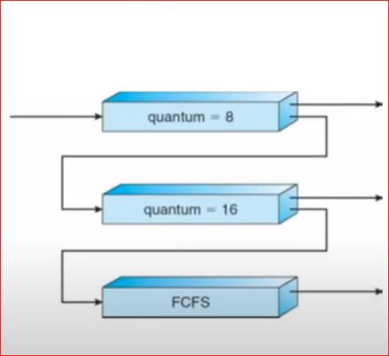
Multilevel Feedback Queue Scheduling...
• Aging of Processes
• Three ready queues (Q0, Q1 and Q2).
• Q0 is the highest priority queue and Q2 is lowest priority queue.
• The scheduler first executes process in Q0
• If process in Q2 wants to execute, only if Q1quantum = 16and Q0 are empty.
• Suppose, the process in Q1 is currently running, if a new process arrived in Q0, then the currently running process is preempted so that the Q0 process can be serviced.

Slide 27
• Any job arriving is put into Q0, and it can run up to 8 mS.
• If the process does not complete, it is preempted and placed at the end of the Q1 queue.
• Time quantum of Q1 is 16ms, the processes can run upto 16 ms, if not finishing in this time are demoted to 02,
• with these processes being executed on a FCFS basis.
• Any jobs that require less than 8ms of the CPU are serviced very quickly.
• Any processes that require between 8ms and 24ms are also serviced fairly quickly.
• Any jobs that need more than 24ms are executed with any spare CPU capacity once Q0 and Q1 processes have been serviced:

